Slide 1
Predicting Future Sales
Eric Huynh
April 2 Springboard Cohort

Slide 2
Problem & Objective
Poorly stocked retail stores ruin the customer experience and satisfaction.
Poor customer experience reduces customer loyalty which in turn reduces repeat business.
Also drives consumers to online shopping where it is much more difficult to keep customers from churning to larger corporations that can sell merchandise at much lower prices.
Objective:
Create a model that can reliably predict the future sales of a product at a shop for up to a month.

Slide 3
Potential Clients
Individual Retail Stores:
Helps predict which products are still desired and capable of creating profitable sales
Keeps track of the efflux of each product to ensure properly stocked inventory
Corporate Retail Stores:
Same applications as individual retail stores, but at higher magnitudes
Properly stocked retail stores are necessary to building corporation reliability
Production Companies:
Create a priority list to focus manufacturing for generating higher sale values
If expanded with geographical information, companies can focus shipments to particular areas with better sale rates

Slide 4
Data from Kaggle Competition
Training Data:
Consists of daily entries from Jan. 1st 2013 to Oct. 31st 2015.
Supplemental Datasets:
“items.csv” – contains information on each of the 22,170 unique items
“item_categories.csv” – contains information for 84 unique item categories
“shops.csv” – contains information for 60 unique shops
Test Data:
Consists of two categorical columns: shop_id and item_id

Slide 5
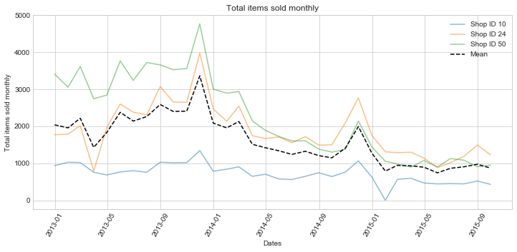
Time-Series
Key Points:
Apparent decline of sales over time.
Reoccuring peak in December of 2013 and 2014.
May be due to seasonal promotion around that time (potentially Christmas and New Years)

Slide 6
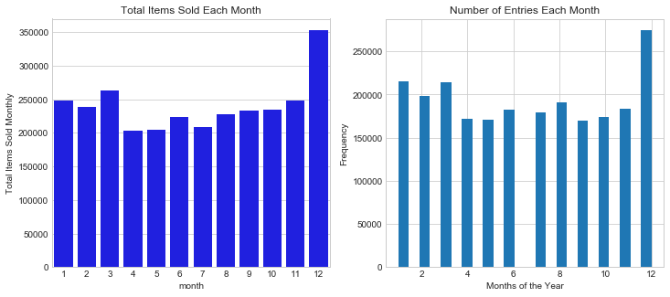
Seasonal Trend
NOTE: Data from 2013 to 2014 only
Key Points:
Increased total sales and total entries during December.
Increase is reflective of data seen in time-series

Slide 7
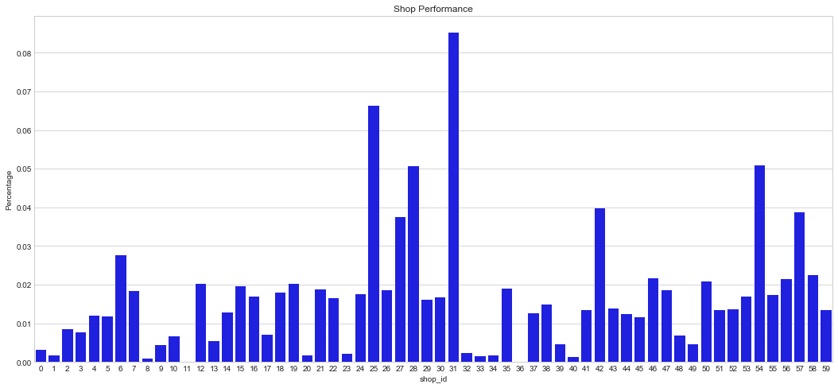
Shop Performance
Key Points:
Many shops performed at the same level
Small number of shops performed significantly better than the rest.
The shops showing similar levels of performance will be grouped

Slide 8
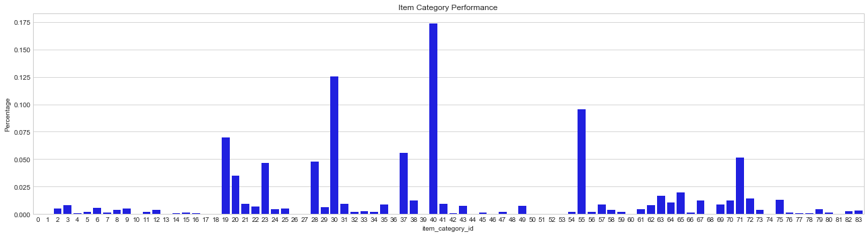
Item Category Performance
Key Points: (similar to shop performance)
Many item categories performed at the same level
Small number of item categories performed significantly better than the rest.
Similarly performing item categories will be grouped

Slide 9
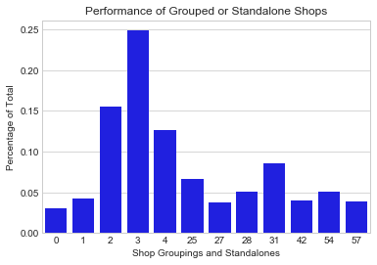
Shop Groupings
60 unique shop IDs -> 5 grouped shop IDs + 8 standalone shop IDs
Group 1: 14 shops performing at 0% - 0.5%
Group 2: 6 shops performing from 0.5% - 1%
Group 3: 12 shops performing from 1% - 1.5%
Group 4: 14 shops performing from 1.5% - 2%
Group 5: 6 shops performing from 2% - 2.5%
Statistical Validation: (t-test between the closet performing groups; p-value < 0.05)
Weakest t-score: -6.7
Weakest p-value: 1.1 * 10⁻⁶

Slide 10
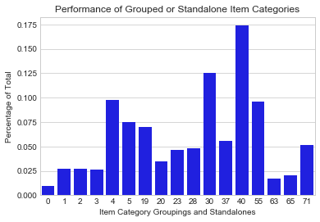
Item Category Groupings
84 unique category IDs -> 6 grouped category IDs + 11 standalone category IDs
Group 1: 29 categories performing at 0% - 0.15%
Group 2: 14 categories performing from 0.15% - 0.3%
Group 3: 7 categories performing from 0.3% - 0.45%
Group 4: 5 categories performing from 0.45% - 0.6%
Group 5: 12 categories performing from 0.6% - 1%
Group 6: 6 categories performing from 1% - 1.5%
Statistical Validation: (t-test between the closet performing groups; p-value < 0.05)
Weakest t-score: -5.97
Weakest p-value: 2.57 * 10⁻⁵

